Slide 1


Slide 2





Some practical information
Network name: Flink Forward 2016
Password: #flinkforward16
Twitter handle: @flinkforward
Hashtag: #ff16
Group photo today at 3.30 pm
All talks will be recorded and can be found on our YouTube channel “Apache Flink Berlin” after the conference
FlinkFest today at Palais starting at 6.10 pm
Attention:
Some last minute changes to the program, please consult online schedule

Slide 3

The Venue

Slide 4







A big thanks to our sponsors!

Slide 5





A big thanks to our program committee!
Tyler Akidau
Google
Stephan Ewen
data Artisans
Jamie Grier
data Artisans
Vasia Kalavri
KTH
Neha Narkhede
Confluent

Slide 6




































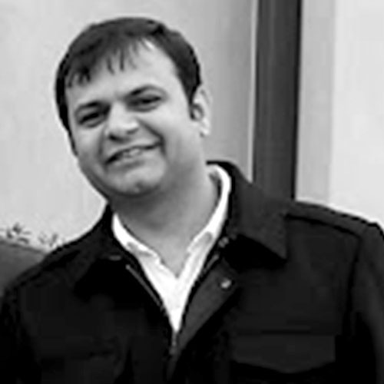



A big thanks to our speakers!

Slide 7

























A big thanks to our speakers!

Slide 8


Kostas Tzoumas Stephan Ewen
Flink Forward
September 12, 2016
The data streaming ecosystem and Apache Flink®: present and future

Slide 9






Founded by the original creators of Apache Flink®, our goal is to make stream processing accessible to the enterprise
Contributing and helping the Flink community grow
Providing enterprise support and services

Slide 10
Streaming is the biggest change in data infrastructure (Flink Forward 2015)
Streaming is a rapidly growing and maturing market category of its own

Slide 11



The Flink community has been at the center of this journey. And there is innovation and convergence in all parts of the stack.
message
transport
compute
engine
programming
paradigm

Slide 12
Why? Streaming technology is enabling the obvious: continuous processing on data that is continuously produced
Hint: you already have streaming data

Slide 13
Data streaming adoption patterns
Real-time products and business monitoring
Robust continuous applications
Decentralized architecture
Unify real-time and historical data
Notes:
Uber, Netflix, Alibaba, Zalando, King

Slide 14

Retail, e-commerce
Better product recommendations
Process monitoring
Inventory management
Finance
Differentiation via tech
Push-based products
Fraud detection
Telco, IoT, Infrastructure
Infrastructure monitoring
Anomaly detection
Internet & mobile
Personalization
User behavior monitoring
Analytics

Slide 15
Largest job has > 20 operators, runs on > 5000 vCores in 1000-node cluster, processes millions of events per second
Complex jobs of > 30 operators running 24/7, processing 30 billion events daily, maintaining state of 100s of GB with exactly-once guarantees
30 Flink applications in production for more than one year. 10 billion events (2TB) processed daily

Slide 16
What is Flink's unique role in the streaming data ecosystem?

Slide 17
Before Flink, users had to make hard choices between:
Volume
Latency
Accuracy

Slide 18
Flink eliminates these tradeoffs
10s of millions events per second for stateful applications
Sub-second latency, as low as single-digit milliseconds
Accurate computation results

Slide 19

A broader definition of accuracy: the results that I want when I want them
Accurate under failures and downtime
Accurate under out of order data
Results when you need them
Accurate modeling of the world

Slide 20
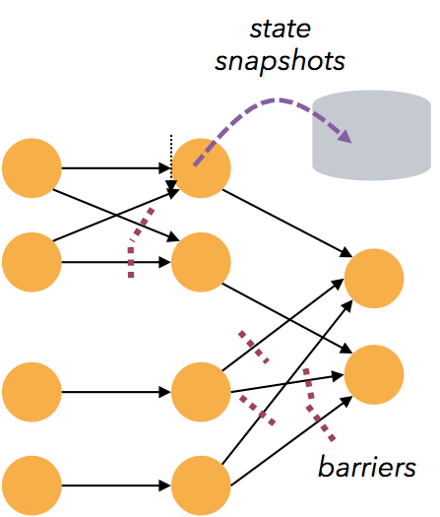
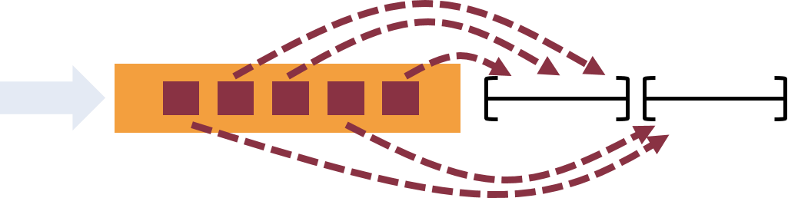
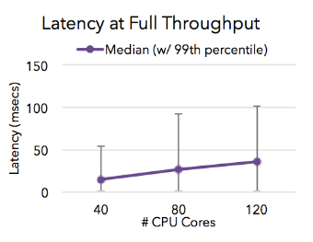
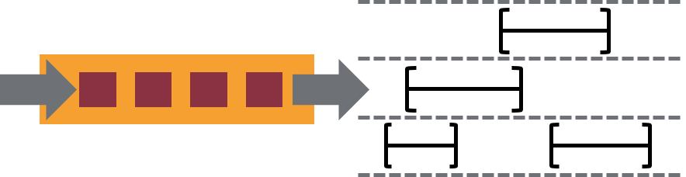
1. Failures and downtime
Checkpoints & savepoints
Exactly-once guarantees
2. Out of order and late data
Event time support
Watermarks
3. Results when you need them
Low latency
Triggers
4. Accurate modeling
True streaming engine
Sessions and flexible windows

Slide 21
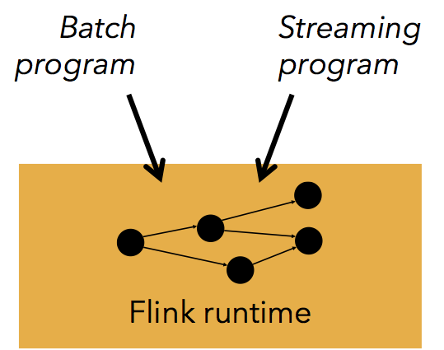



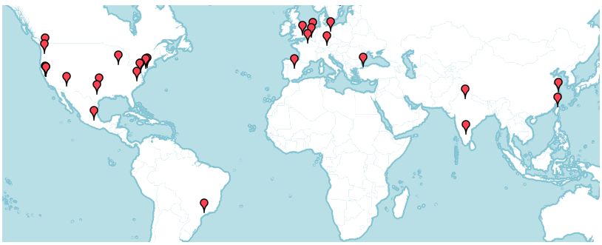




5. Batch + streaming
One engine
Dedicated APIs
6. Reprocessing
High throughput, event time support, and savepoints
flink -s <savepoint> <job>
7. Ecosystem
Rich connector ecosystem and 3rd party packages
8. Community support
One of the most active projects with over 200 contributors

Slide 22
What are the next steps for Flink?

Slide 23
Provide state of the art streaming capabilities (✔)
Operate in the largest infrastructures of the world
Open up to a wider set of enterprise users
Broaden the scope of stream processing

Slide 24
Apache Flink today
The Apache Flink community has pushed the boundaries of open source stream processing.

Slide 25
Flink's unique combination of features
Low latency
Out-of-order events
Consistency
High Throughput
Well-behaved flow control (back pressure)
Works on real-time and historic data
Performance
Event Time
Fluent API
Windows & user-defined state
Stateful Streaming
APIs Libraries
Complex Event Processing
Exactly-once semantics for fault tolerance
Flexible windows (time, count, session, roll-your own)
Savepoints (replays, A/B testing, upgrades, versioning)
Fast and large out-of-core state

Slide 26
Flink v1.1
Metric System
Library enhancements
Connectors
(Stream) SQL
Session Windows

Slide 27
Flink v1.1 + current threads
Dynamic Scaling
Metric System
Metrics & Visualization
Dynamic Resource Management
Fine grained recovery
Savepoint compatibility
Checkpoints to savepoints
Large state Maintenance
Authentication
Security
Library enhancements
Mesos & others
Side in-/outputs
Connectors
Window DSL
Queryable State
More connectors
Stream SQL Windows
(Stream) SQL
Session Windows

Slide 28
Flink v1.1 + current threads
Dynamic Scaling
Metric System
Metrics & Visualization
Dynamic Resource Management
Fine grained recovery
Savepoint compatibility
Operations
Checkpoints to savepoints
Large state Maintenance
Authentication
Security
Library enhancements
Mesos & others
Ecosystem
Broader Audience
Application Features
Side in-/outputs
Connectors
Window DSL
Queryable State
More connectors
Stream SQL Windows
(Stream) SQL
Session Windows

Slide 29
Flink v1.1 + current threads
Dynamic Scaling
Metric System
Metrics & Visualization
Dynamic Resource Management
Fine grained recovery
Savepoint compatibility
Operations
Checkpoints to savepoints
Large state Maintenance
Authentication
Security
Library enhancements
Mesos & others
Ecosystem
Broader Audience
Application Features
Side in-/outputs
Connectors
Window DSL
Queryable State
More connectors
Stream SQL Windows
(Stream) SQL
Session Windows

Slide 30
Flink v1.1 + current threads
Dynamic Scaling
Metric System
Metrics & Visualization
Dynamic Resource Management
Fine grained recovery
Savepoint compatibility
Operations
Checkpoints to savepoints
Large state Maintenance
More details in the Talk "The Future of Apache Flink" (Monday, 11:00)
Authentication
Security
Library enhancements
Mesos & others
Ecosystem
Broader Audience
Application Features
Side in-/outputs
Connectors
Window DSL
Queryable State
More connectors
Stream SQL Windows
(Stream) SQL
Session Windows

Slide 31


Security / Authentication
No unauthorized data access
Secured clusters with Kerberos-based authentication
Kafka, ZooKeeper, HDFS, YARN, HBase, …
No unencrypted traffic between Flink Processes
RPC, Data Exchange, Web UI
Prevent malicious users to hook into Flink jobs
See talk
"Flink Security Enhancements" (Tuesday, 11.45)
Largely contributed by

Slide 32



Checkpoints / Savepoints
Recover a running job into a new job
Recover a running job onto a new cluster
Application state backwards compatibility
Flink 1.0 made the APIs backwards compatible
Now making the savepoints backwards compatible
Applications can be moved to newer versions of Flink even when state backends or internals change
v1.x
v1.y
v2.0

Slide 33
Dynamic scaling
Changing load bears changing resource requirements
Need to adjust parallelism of running streaming jobs
See talk
"Dynamic scaling: How Apache Flink adapts to changing workloads" (Tuesday, 14.45)
Re-scaling stateless operators is trivial
Re-scaling stateful operators is hard (windows, user state)
Efficiently re-shard state
Workload
Resources
Re-scaling Flink jobs preserves exactly-once guarantees
time

Slide 34






Cluster management
Series of improvements to seamlessly interoperate with various cluster managers
YARN, Mesos, Docker, Standalone, …
Proper isolation of jobs, clean support for multi-job sessions
Dynamic acquire/release of resources
Using mixed container sizes
Driven by
and
Mesos integration contributed by

Slide 35
Cluster management
Series of improvements to seamlessly interoperate with various cluster managers
YARN, Mesos, Docker, Standalone, …
Proper isolation of jobs, clean support for multi-job sessions
See talk
"Running Flink Everywhere" (Monday, 16.45)
See talk
"Introducing Flink on Mesos" (Tuesday, 11.30)
Dynamic acquire/release of resources
Using mixed container sizes
Driven by
and
Mesos integration contributed by

Slide 36

Stream SQL
SQL is the standard high-level query language
A natural way to open up streaming to more people
Problem: There is no Streaming SQL standard
At least beyond the basic operations
Challenging: Incorporate windows and time semantics
Flink community working with Apache Calcite to draft a new model

Slide 37
Stream SQL
SQL is the standard high-level query language
A natural way to open up streaming to more people
See talk
"Streaming SQL" (Monday, 11:00)
See talk
"Taking a look under the hood of Apache Flink’s relational APIs" (Monday, 16.45)
Problem: There is no Streaming SQL standard
At least beyond the basic operations
Challenging: Incorporate windows and time semantics
Flink community working with users and with Apache Calcite to draft a new model

Slide 38
Looking further

Slide 39
Streaming and batch
The separation of batch and streaming …
… has been largely technology driven (not by use cases)
… is quite artificial
People are approaching Flink for batch processing as well
In fact – several talks here are about batch processing…

Slide 40

Streaming and batch
partition
partition
2016-3-1 12:00 am
2016-3-1 1:00 am
2016-3-1 2:00 am
…
2016-3-11 10:00pm
2016-3-11 11:00pm
2016-3-12 12:00am
2016-3-12 1:00am
2016-3-12 2:00am
2016-3-12 3:00am

Slide 41
Streaming and batch
Stream (low latency)
partition
partition
2016-3-1 12:00 am
2016-3-1 1:00 am
2016-3-1 2:00 am
…
2016-3-11 10:00pm
2016-3-11 11:00pm
2016-3-12 12:00am
2016-3-12 1:00am
2016-3-12 2:00am
2016-3-12 3:00am
Stream (high latency)

Slide 42
Streaming and batch
Stream (low latency)
partition
partition
2016-3-1 12:00 am
2016-3-1 1:00 am
2016-3-1 2:00 am
…
2016-3-11 10:00pm
2016-3-11 11:00pm
2016-3-12 12:00am
2016-3-12 1:00am
2016-3-12 2:00am
2016-3-12 3:00am
Batch
(bounded stream)
Stream (high latency)

Slide 43
Why use batch at all now?
Possible to add to DataStream API
… dedicated batch processors
… or Flink's DataSet API
Missing primitives (example: BSP iterations)
Resource elasticity /
efficiency
Cost of fault tolerance and accuracy
Deeper integration between batch and streaming techniques

Slide 44
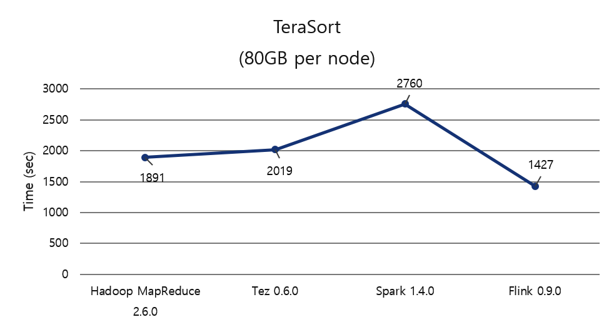
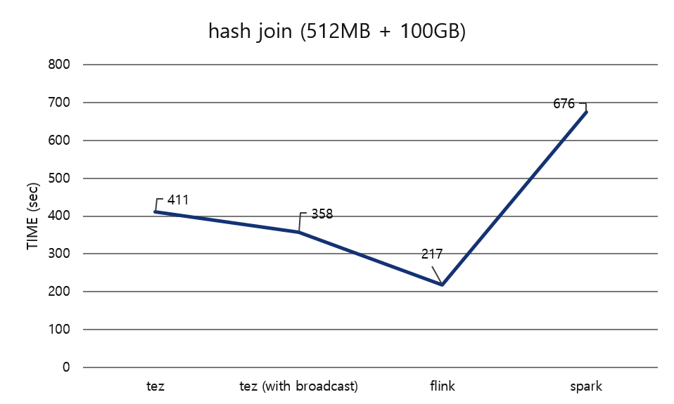
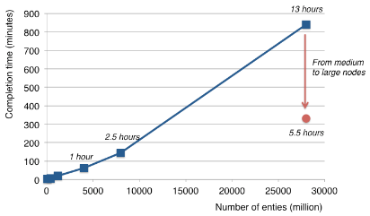
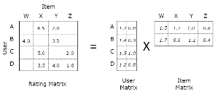
Some batch proof points…
TeraSort
Classic Batch Jobs
Relational Join
Linear Algebra
Graph Processing

Slide 45


State in stream processing
Stateless Streaming
(Apache Storm)
Stateful Streaming
(Apache Samza)
Accurate Stateful Streaming
(Apache Flink)
State sizes in Flink today (my assessment): 10s gigabytes per operator
How to scale this to many terabytes?
Queryable State
Data driven triggers over large state

Slide 46
Large-state streaming
How to scale the stream processor state?
… and maintain fast checkpoint intervals?
… and have very fast recovery on machine failures?
More and more database techniques coming into Flink

Slide 47
…in conclusion
Flink is running in some of the largest streaming setups
Community is working on adding many state-of-the-art operational features
Available to broader audiences, via Stream SQL
Streaming has even more potential to subsume batch and will hold more and more application state

Slide 48

Enjoy the conference!

